Slide 1
education growing in demand Traditional Versus online
Cindy Herrera
DSC 530

Slide 2
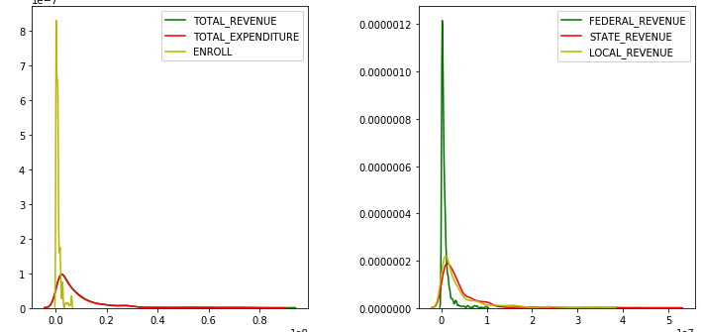
Meeting the Education growing demand
Elementary and secondary public school revenues totaled $632 billion in school year 2013–14. Of this total, 9 percent of revenues were from federal sources, 46 percent were from state sources, and 45 percent were from local sources.

Slide 3
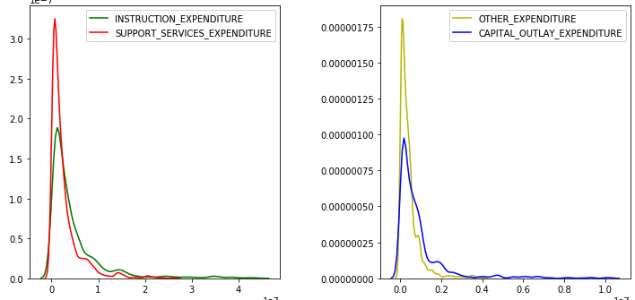
In school year 2013 / 14, elementary and secondary public school revenues totaled 632 billion, in constant 2015–16 dollars.1 Of this total, 9 percent, or 55 billion, were from federal sources; 46 percent, or 292 billion, were from state sources; and 45 percent, or 284 billion, were from local sources. In 2013–14, the percentages from each source differed across the states and the District of Columbia. For example, the percentages of total revenues coming from federal, state, and local sources in Illinois were 8 percent, 26 percent, and 66 percent, respectively, while the same total revenues in Vermont were 6 percent, 90 percent, and 4 percent. Total elementary and secondary public school revenues were 7 percent higher in 2013–14 than in 2003–04 (632 billion versus 592 billion, in constant 2015–16 dollars). During this time, total revenues rose from 592 billion in 2003–04 to $658 billion in 2007–08 and then fell each year between 2008–09 and 2012–13. Total revenues then rose from 622 billion in 2012–13 to 632 billion in 2013–14. These changes were accompanied by a 3 percent increase in total elementary and secondary public school enrollment, from 49 million students in 2003–04 to 50 million students in 2013–14 (see indicator Elementary and Secondary Enrollment).

Slide 4
The total States with positive final results is only 20

Slide 5
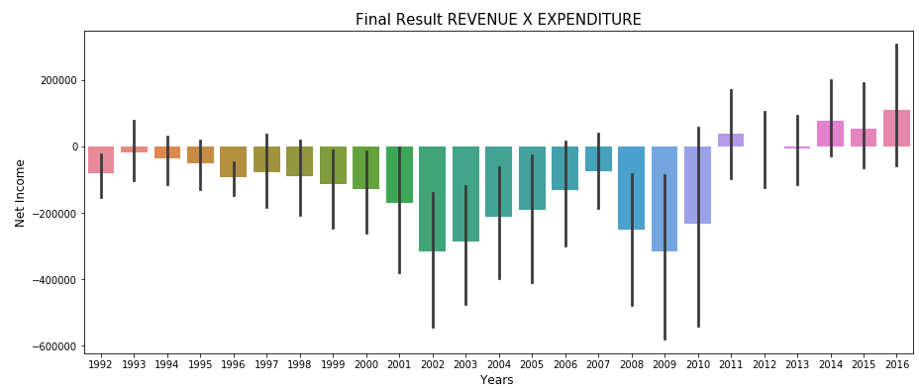
Knowing the FINAL AMOUNT by YEAR

Slide 6
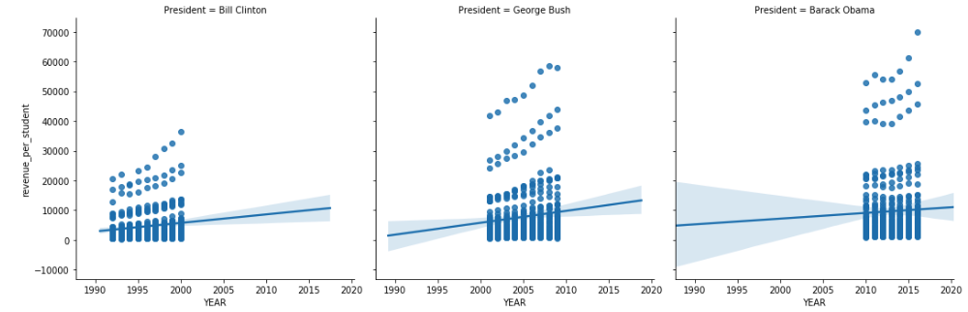
with the respective the President by Period

